Slide 1
Python workshop
Street racing game
Team name: ABD
Team number: 16
Team mentor: Mr.joelanandraj
Dept of IT , kite

Slide 2
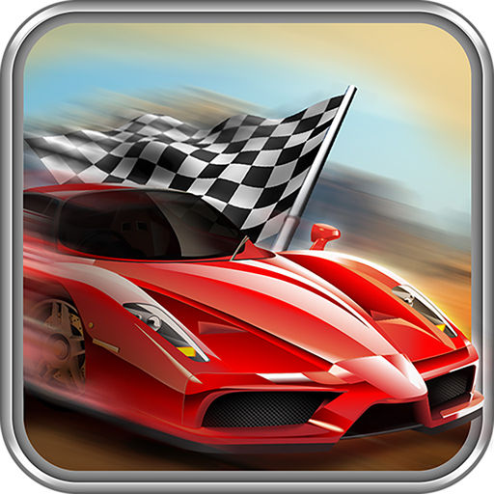
TITLE
Street racing
game

Slide 3
INDUSTRY MENTOR
MS. U.subashini
Associate
Kgisl gss

Slide 4
TEAM MEMBERS
DEEPA . K
ARAVINDRAJ SUNDARAMURTHI
BALAGANAPATHY . V

Slide 5
ABSTRACT
The title of the program is street racing . The main objective of the program is the car should not be crashed in the highway. We are focusing on developing a 2d street racing game using pygame. This will cover implementation of graphics, physical engine, as well as sound effect and background music. This game fully based on levels ,score ,distance and time .

Slide 6
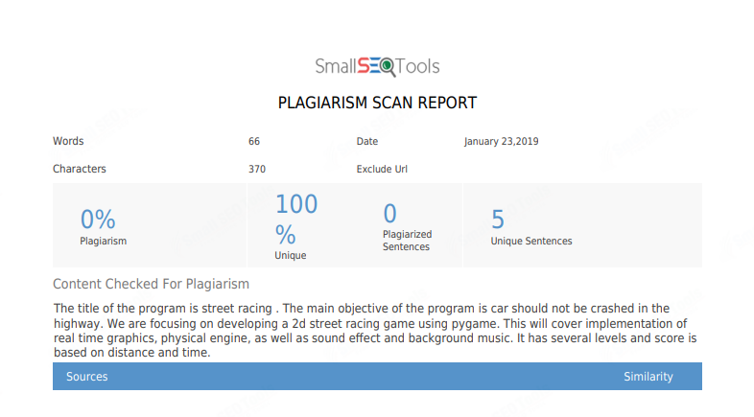

Slide 7
modules
players: single player only can play.
Levels: Infinity levels based on distance.
Timer: The score based on time.
Pause: If we need to stop the game press “p” button.
Score: It based on distance we traveled.

Slide 8
Model architecture
Start the game
one level
Car runs
Pause the game
when Car crash
End the game

Slide 9
requirements
Hardware :
PENTIUM 4
Software :
THONNY
Language:
python programming

Slide 10
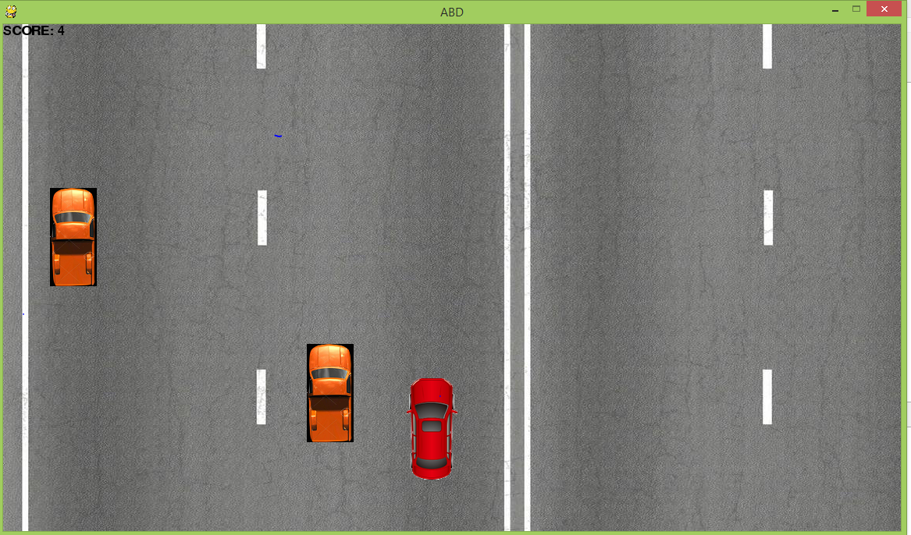
pygame

Slide 11

THANK YOU…

